Slide 1

Citi Bike Data Analysis
By Neo Mosebi

Slide 2
Project goal:
To better understand the behaviour of Citi Bike’s customer base (both one-time users and subscribers) and how they use Citi Bikes.
This will help us to:
Identify where more bike stations should be installed.
Create targeted marketing campaigns that will appeal to different customers.

Slide 3
Key questions:
What are the most popular pick-up locations across the city for Citi Bike rental?
How does the average trip duration vary across different age groups?
Which age group rents the most bikes?
How does bike rental vary across the two user groups ( one-time users vs subscribers) on different days of the week?
Does the factor of user age impact the average bike trip duration?

Slide 4

Findings & insights

Slide 5
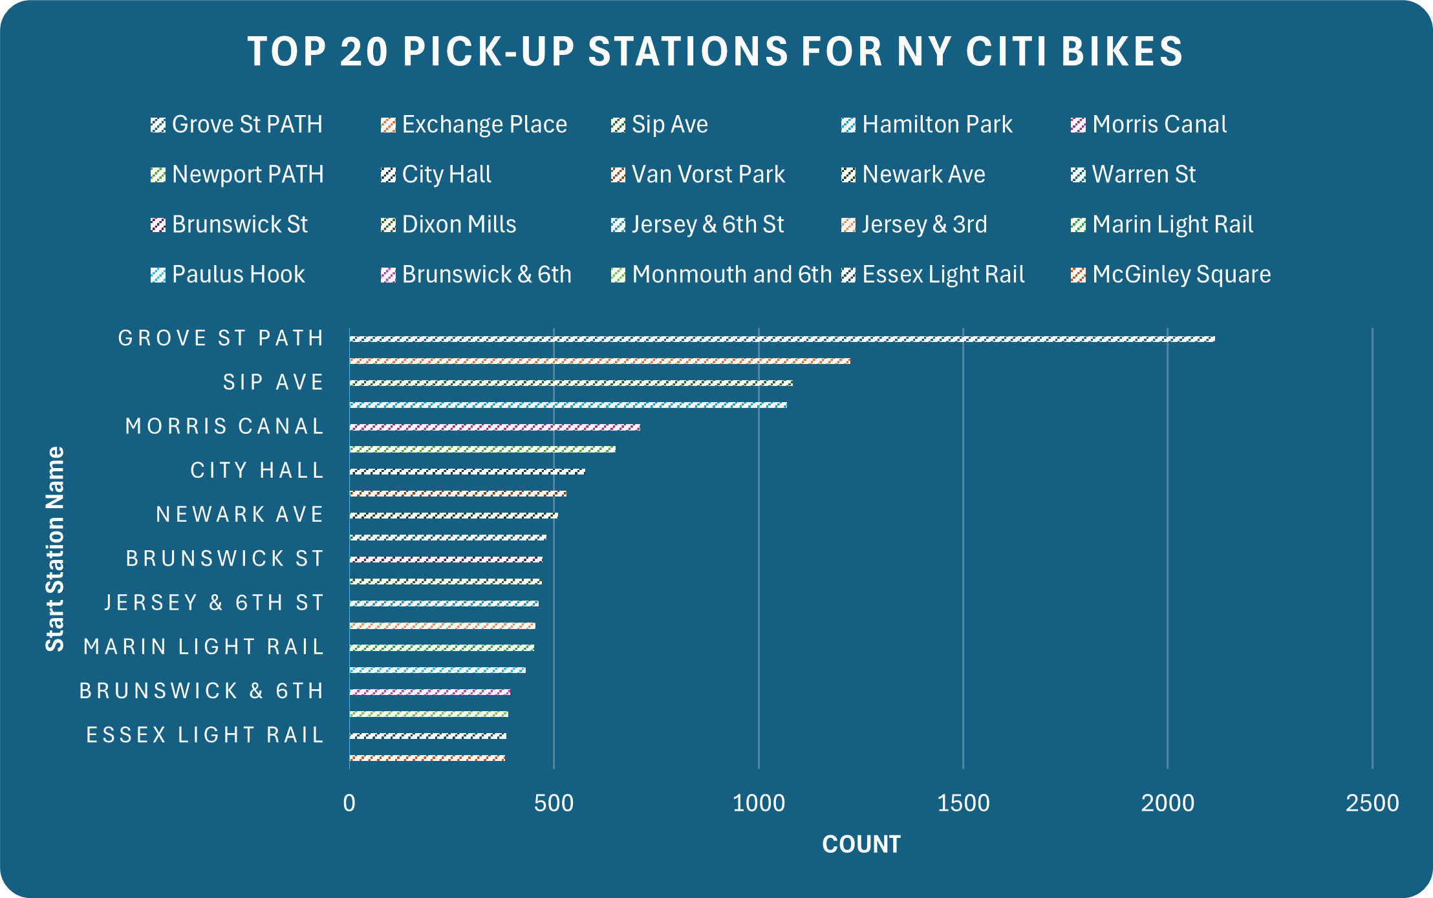
1. What are the most popular Citi Bike pick-up locations?
This is a summary of the 20 most popular pick-up stations in New York.

Slide 6
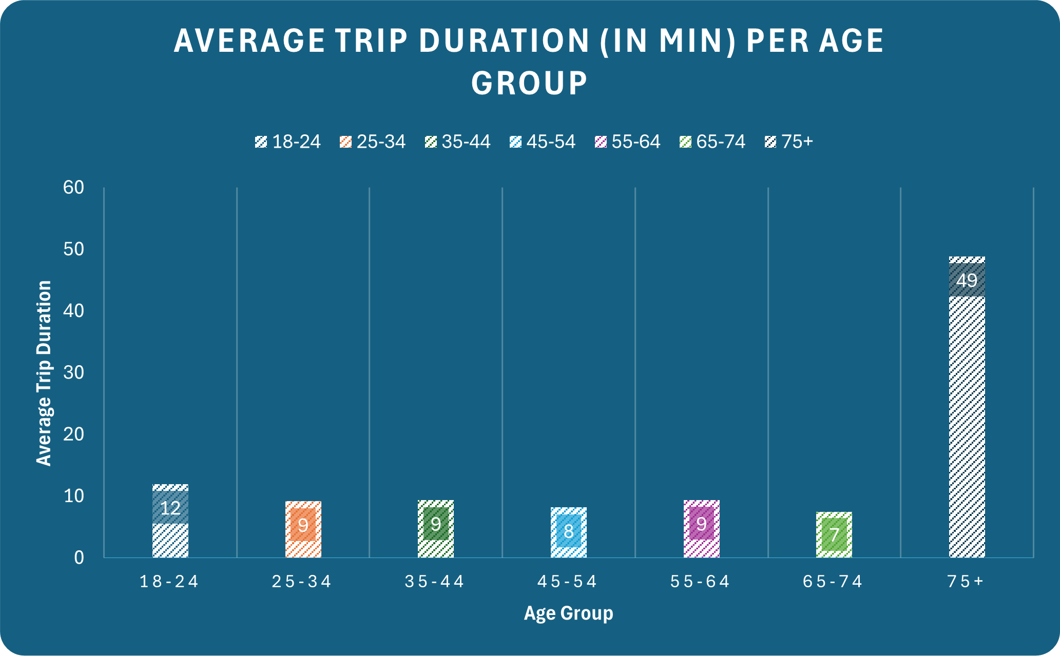
2. How does the average trip duration vary across different age groups?
75+ age group take longer rides than the younger age groups.

Slide 7
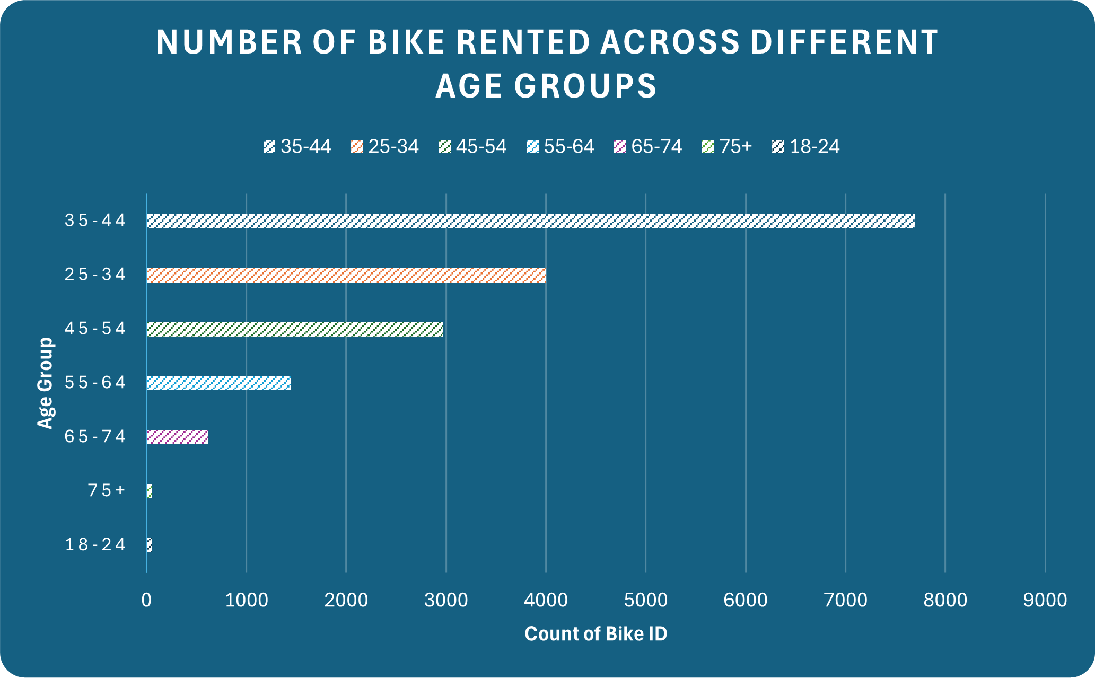
3. Which age group rents the most bikes?
The 35-44 age group rents more bikes even though they ride less.

Slide 8
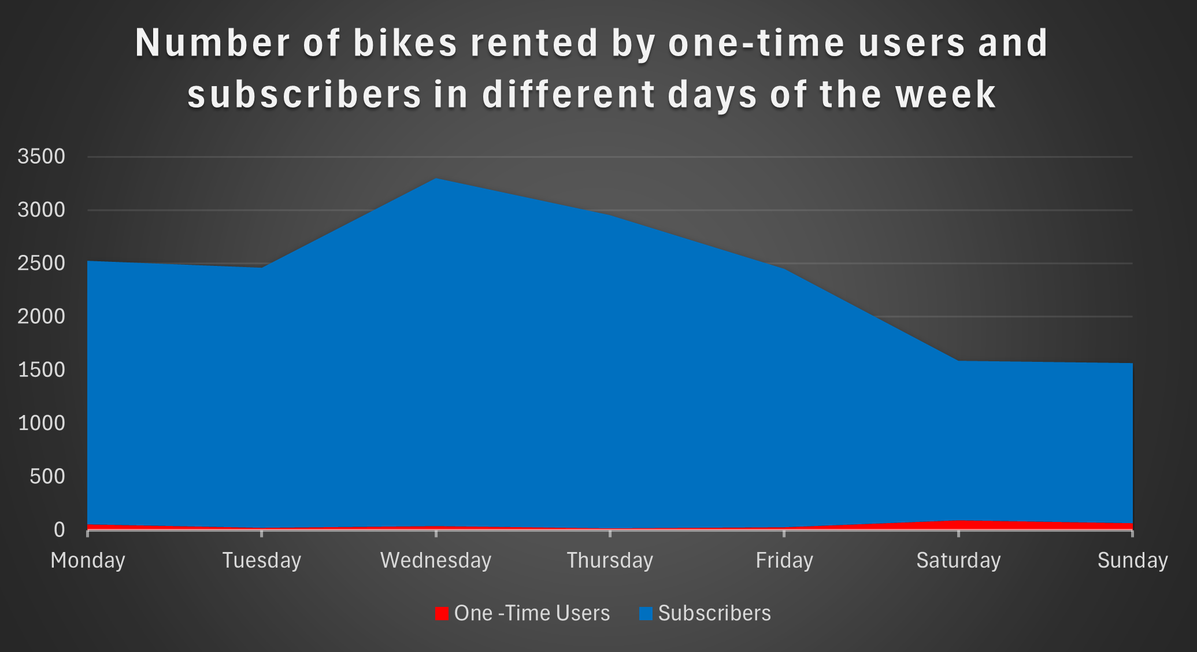
4. How does bike rental vary between the two user groups on different days of the week?
Subscriber are mostly active during the weekdays and showing a drop on the weekends

Slide 9
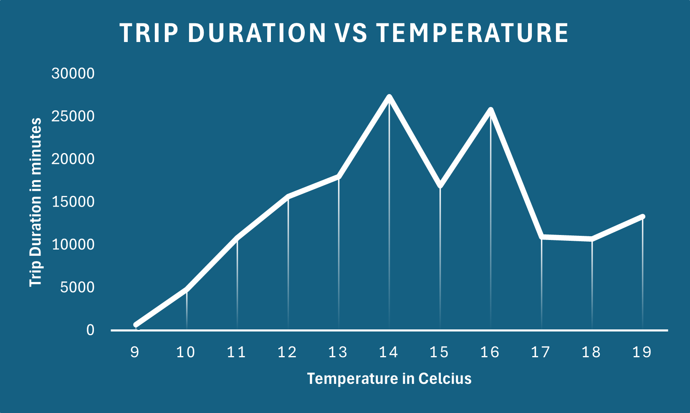
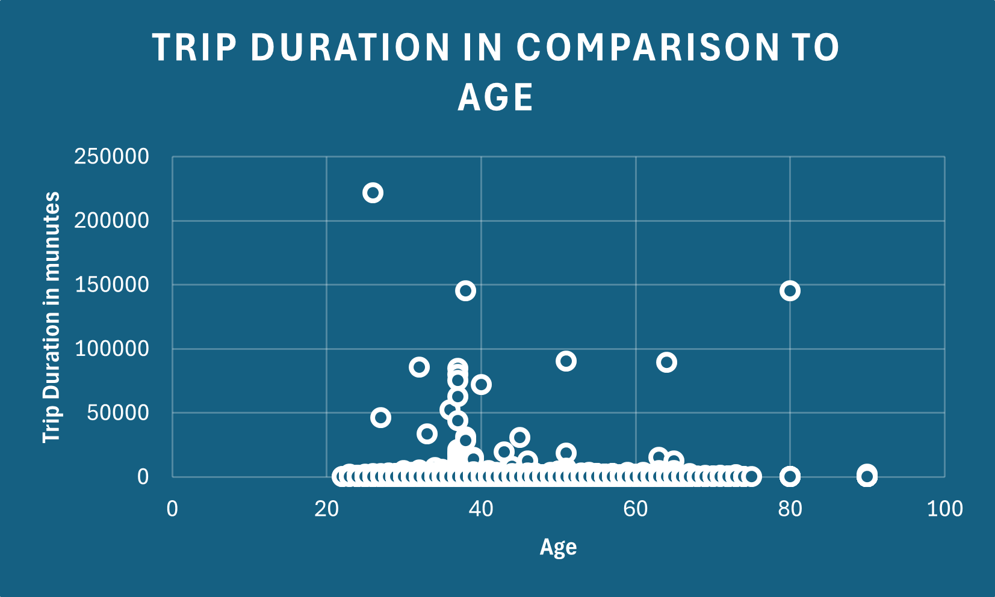
5. Do factors like weather and age impact the average bike trip duration?
Temperature does not have direct impact to the duration of the trips. Age does not seem to impact
Trip duration either as on average, 70+ takes longer trips

Slide 10
Summary

Slide 11
Summary of findings:
Top 5 pick-up locations for bikes:
Grove St Path, Exchange Palace, Sip Ave, Hamilton Park, & Morris Canal
Customer base:
Most customers are Subscribers and most users being between the ages of 35-44
Citi Bike customer behaviour:
Age 22 takes the shortest trips on average
Age 90 takes the longest trips on average

Slide 12
Actions & recommendations

Slide 13
Recommended actions:
Product recommendations:
Install more bikes at Grove St Path, Exchange Palace, Sip Ave, Hamilton Park, & Morris Canal
Marketing recommendations:
The Citi Bike customer base is mostly Subscribers, aged between 35-44, who are most active on Weekdays. This tells us that they are probably people who live in New York and use Citi Bikes to commute. Marketing and advertising campaigns should therefore target this demographic

Slide 14

Thank you!

